Slide 1
COMP207
Database Development
2025-26
Rasmus Ibsen-Jensen

Slide 2
What is this course all about?
Databases…
Developments
Roughly half is also about concurrency

Slide 3
Questions?
If you have a question, pick one:
If during a lecture, you can raise your hand and I will let you ask it when I notice you
You can ask after/before a lecture
Just outside the room however
Ask during the labs I attend
I intend to attend every second week
Ask on the online discussion board in the dedicated thread
If the question is personal and should not be shared, you can ask it by email: R.Ibsen-Jensen@Liverpool.ac.uk

Slide 4
Attendance monitoring
As you might have heard, we are required to monitor attendance in lectures
It is done as follows:
You log in on timetables.liverpool.ac.uk
or download UoL timetables app
You find the session you want to register for
during the session
You click on it
Click on “Register your attendance”
You then write in a 6-digit code we give you during each session
Click “Register”

Slide 5
EvaSys from last year
Students mentioned that they would like more interaction in the lectures and some suggested quizzes
I will do so by adding in some quizzes with exam questions from recent exams in each lecture
… INCL. THIS ONE!

Slide 6
Databases are everywhere

Slide 7
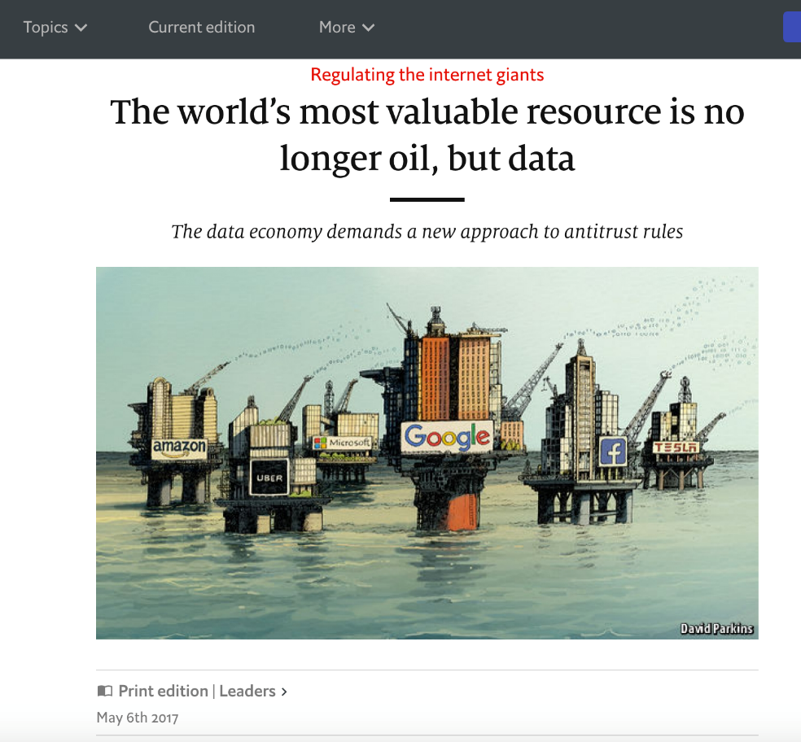

… and are valuable

Slide 8


Databases Drives the Web
User
Web service
Database
Online store
Social media site
Airline/train/hotel reservation
– many more –

Slide 9
Databases Drives the Web
User
Amazon.com
Database
2.5 billion users per month
>353 million products
spread over a number of databases
millions of users per day many at the same time

Slide 10
Databases Drives the Web
User
Facebook.com
Database
user information, links, posts, pictures, …
loading the homepage of a user requires accessing 100s of servers
Roughly 5 million servers in 2020
(from: power usage (7.1 terawatts)
and avg server (around 1megawatt)
and a few more details)
Roughly 2.09 billion users daily

Slide 11
Databases Drives the Web
Requires extremely efficient systems for querying data, and for storing and manipulating data in a safe way.
User
Facebook.com
Database
user information, links, posts, pictures, …
loading the homepage of a user requires accessing 100s of servers
Roughly 5 million servers in 2020
(from: power usage (7.1 terawatts)
and avg server (around 1megawatt)
and a few more details)
Roughly 2.09 billion users daily

Slide 12

Databases Drives Businesses
Banking: debit/credit card transactions
E.g., in stores/super markets, at ATMs, etc.
Stock market
Big companies & organisations:
Employees, customers, products, sales, schedules, logistics, clients, etc.
Purposes:
Some are worthwhile directly
Management, data analytics and decision making

Slide 13

Databases in Science & Public Service
Science: for data management and data analysis in
Astronomy
Human Genome
Biochemists exploring properties of proteins
Biology and life sciences
Geology
Medicine/NHS:
Patient records
Diseases and their relationships, treatments, etc.
Decision making
Many others
Not always using proper databases!
Notes:
Mention Hartree Centre

Slide 14
Early Data Management
Early DBMS of the 1960’s were based on this idea
Disadvantages:
difficult to program
not very robust, especially when dealing with updates to data by many users in parallel
Hard to add fields or new efficient queries
Anna, 20181989, G402
John, 20184378, G702
…
class Student {
String name;
int number;
String programme;
…
}
Vector<Student> students;
…
External data file

Slide 15




Relational Databases to the Rescue…
Modern database management systems (DBMSs) are based on 50+ years of database research
Very sophisticated tools
Can manage very large amounts of data over a long period of time
Highly efficient, flexible, robust
Notes:
Modern database management systems (DBMSs) are extremely sophisticated tools that enable us to handle large amounts of data in an efficient, flexible and safe way.
…these systems have come a long way…

Slide 16
Relational Model
(Informally it is called SQL model)
Data organised as relations (“tables”)
Data is queried/modified at a high level (e.g. via SQL) No need to know how data is stored and where
Introduced in 1970, most dominant model by 1990
Employees
Items
birthday | first_name | family_name
1990-11-10 | Anne | Smith
2000-02-05 | David | Jones
… | … | …
name | price | number
2L Cola | 3.00 | 30
Banana | 0.10 | 120
… | … | …

Slide 17

Relational DBMS are one of the biggest success stories in computer science.
Also: one of the most complex pieces of software…

Slide 18
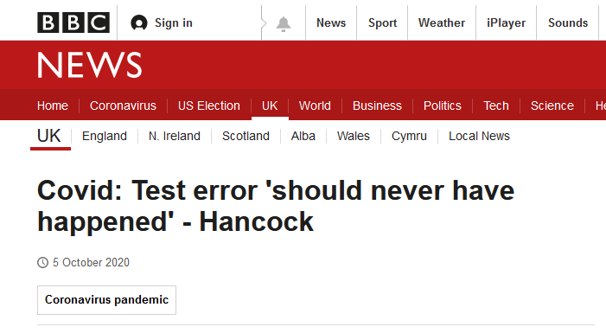
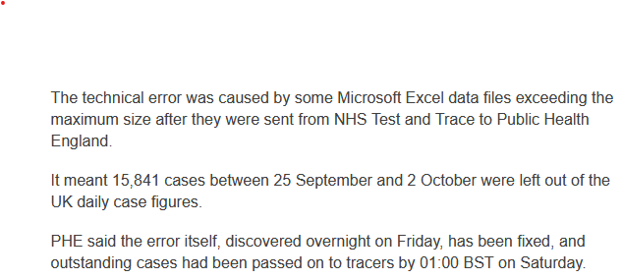
NHS example

Slide 19

University of Liverpool example

Slide 20
Horizon/Post office scandal
Long-running scandal (that said people in the UK started caring about it this year) abt. the post office that put their post officers in jail after accusing them of stealing
Many post officers had done nothing wrong but were convicted due to bugs in the IT system Horizon
Some (but not all) of the bugs had to do with databases
Will discuss some examples in week 3

Slide 21

Course overview
What are we doing in each lecture?

Slide 22
Basics of SQL and the relational model
First two weeks (lectures 2-5):
We will show you how to make relational databases
How to insert/delete/query them
Module
Student
code | name | lecturer
COMP207 | Database Development | R. Ibsen-Jensen
COMP219 | Artificial Intelligence | F. Oliehoek
… | … | …
name | number | programme
Anna | 20181989 | G402
John | 20184378 | G702
… | … | …

Slide 23
Relational DBMS Components (Simplified)
User/application
Transaction Management (lectures 6-11)
Query Compiler
Transaction manager
Query Processing (lectures 12-13)
Execution Engine
Logging and recovery
Concurrency control
Index/file/record manager
Buffers
Storage
Buffer manager & storage manager

Slide 24
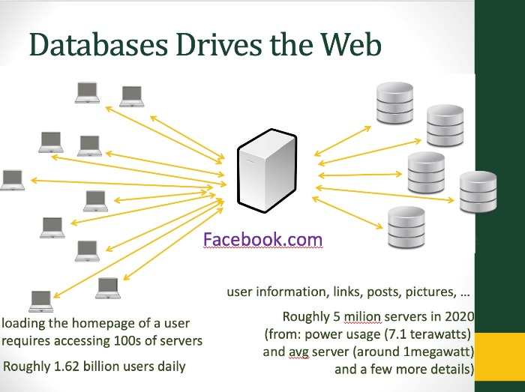
Beyond Plain Relational DBMS
Distributed DBMSs (lecture 14)
Beyond relational data (lectures 15-18)
Called NoSQL databases
Data warehouses/analysis/mining (lectures 19-20)
Efficiency
Relational
Semi-structured
Key-value stores
Features
Transaction Management (lectures 6-11)
Distributed DBMSs (lecture 14)

Slide 25
What you should be able to do at the end (Learning Outcomes)
Basic/advanced SQL:
Application in problem solving (focused on in week 1,2 and 6)
I.e. SQL and query processing
Transaction management:
Identify and apply the principles underpinning transaction management within DBMS (focused on in weeks 3,4,5 and 7)
I.e. transaction management and distributed databases
Web technologies:
Illustrate issues related to web technologies as a semi-structured data representation formalism (focused on in weeks 8 and 9)
Data warehouses and data mining:
Interpret the main concepts and security aspects in data warehousing
Interpret the main concepts of data mining
Focused on in week 10

Slide 26
Topics We Will Not Cover
No modelling of databases
No administration of DBMS
No implementation of database system components

Slide 27
Some words on logistics…

Slide 28
Lectures & Labs/Tutorials
20 “lectures” in total (week 1-10)
10 weeks of labs
All are on Fridays
They start this week!
Each week, you have 1 lab hour
You should be assigned to one of the lab sessions
If not: let me know as soon as possible

Slide 29
Format for lectures
Each week we have 2 lectures
The lectures will focus on examples: You NEED to watch the online videos for definitions and similar before the Wednesday lecture currently
Exception: The first two weeks focus on SQL and should be possible to follow without the videos
If you struggle (with or) without watching let me know
From week 3 onwards, I very much expect that you won’t be able to follow the lectures if you did not watch the videos
If you struggle while watching, do let me know
If you do manage without the videos and no prior knowledge on the subject, do let me know, because I would be impressed

Slide 30
Resources
Course page on Canvas:
Announcements, videos, slides, assessments, stream lectures, discussion board, etc.
Let me know if you don’t have access
Textbooks (any is fine):
Garcia-Molina, Ullman and Widom: Database Systems – The Complete Book, Pearson Education
Free e-book
Elmasri and Navathe: Fundamentals of Database Systems, Pearson Education
Also free e-book, but that might be removed
Connolly and Begg: Database Systems, Addison Wesley
Your own notes + the web

Slide 31
Exam
The exam is 60% of your grade
It has 30 MCQs
Each MCQ has:
5 options and you pick one
One is correct
Each correct answer gives 1 point (i.e. 2% of the final grade), and each wrong answer 0 point
You will get more information about it in the last lecture and get some mock exams and similar towards the end

Slide 32

Example question
Which of the following is not an example of a NoSQL database?
Relational database
Semi-structured database
Key-value stores
Graph databases
All the above are examples of NoSQL databases
PollEv.com​/databasedevelop

Slide 33
Main assessment
There will be a 25% main, practical assessment in SQL with the deadline Thursday the 13th of November at 17:00
Will discuss this main assessment the week after next
It will be about a supermarket though

Slide 34
Weekly assessment
There will be a weekly assessment, one for each of the 10 weeks
Each will have 3 MCQs similar to the exam
Each will give 1.5% and you will have 30 mins to do it once started (i.e. each question gives 0.5%)
They are based on the lectures, labs and quizzes associated with the corresponding week
They run from Monday at 17:00 until Monday at 17:00 the week after
I.e. there is one with a deadline next Monday!

Slide 35
Weekly survey
Each week (running Friday to Friday), there will be a survey, asking the following questions:
Can you list 1-3 things that worked particularly well this week in the course (and come with feedback explaining why you liked that if possible)?
Can you list things that did not work well during this week in the course (1-3, but if there are more, please list those as well) - preferably with some explanation if it is not self-evident.
Each Tuesday, I will go over the survey from the previous week, during the lecture, and explain how I will address the issues raised

Slide 36
Summary
Database systems
Success story…
Understanding how they work is important
For practitioners and researchers alike
This is what this course is about

